Slide 1
Evaluate Interface Learnability with Cognitive Walkthroughs
Learnability is a crucial component of UX for complex and novel interfaces. Cognitive walkthroughs can identify design problems that derail new users.

Slide 2
A cognitive walkthrough is a task-based usability-inspection method that involves a crossfunctional team of reviewers walking through each step of a task flow and answering a set of prescribed questions, with the goal of identifying those aspects of the interface that could be challenging to new users.

Slide 3
During the evaluation of a given task, the facilitator performs the task and stops at each new screen or other discrete step in the interaction. To establish whether the user is likely to succeed at this step of the flow, evaluators discuss 4 key questions (analysis criteria) meant to uncover potential causes for failure:

Slide 4
Will users try to achieve the right result?
In other words, do users understand that the action (step) at hand is needed to reach their larger goal?

Slide 5
Will users notice that the correct action is available?
In other words, is the interactive element that achieves the step visible or easily findable?

Slide 6
Will users associate the correct action with the result they’re trying to achieve?
Perhaps the right button is visible, but will users understand the label and will they know to engage with it?

Slide 7
After the action is performed, will users see that progress is made toward the goal?
Based on what occurs after the action is taken, will users know that this action was correct and helped them make progress toward their larger goal?

Slide 8
Let’s look at an example. Imagine a tablet interface used by health-clinic patients to check in for a visit and update their patient information. To assess the user experience using a cognitive walkthrough, the reviewers would focus on evaluating the steps that patients go through within the interface to complete these activities in preparation for their visit.

Slide 9
Checkin: A patient new to the clinic arrives for an appointment and is asked by the receptionist to check-in using the provided tablet application.
Record update: ­ A returning patient arrives for an appointment and is asked by the receptionist to review and update patient information and health history using the provided tablet application.

Slide 10
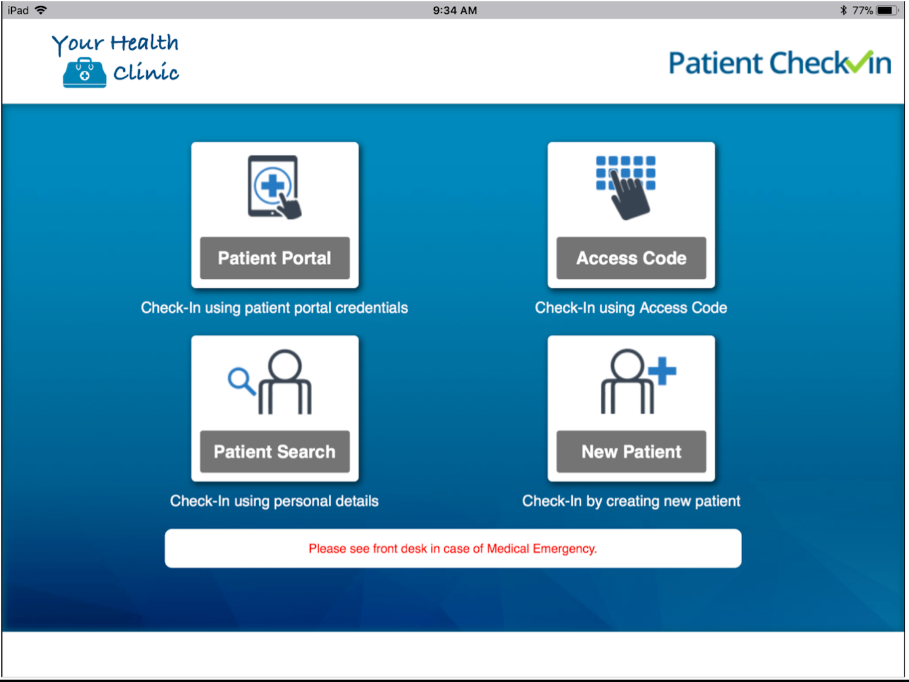
Let’s dive deeper into the first user task, patient checkin. During the cognitive-walkthrough session, the group begins by looking at the first screen that the user would encounter when trying to complete the check-in. In the example screenshot below, the correct action for the new patient would be to tap the square in the bottom right corner.

Slide 11
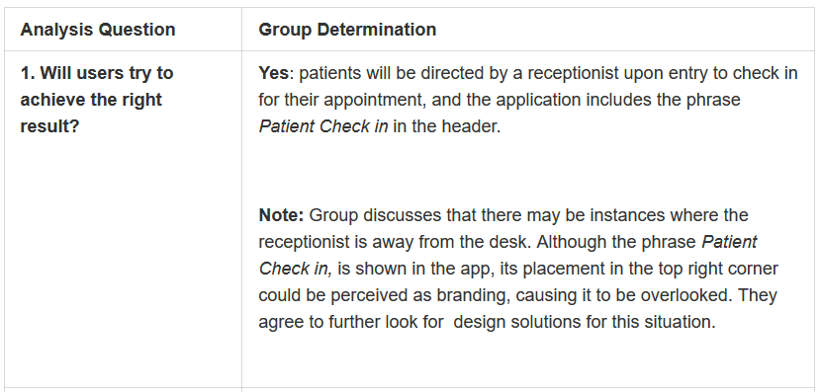

Slide 12
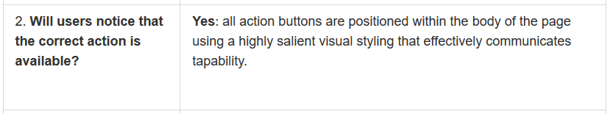

Slide 13
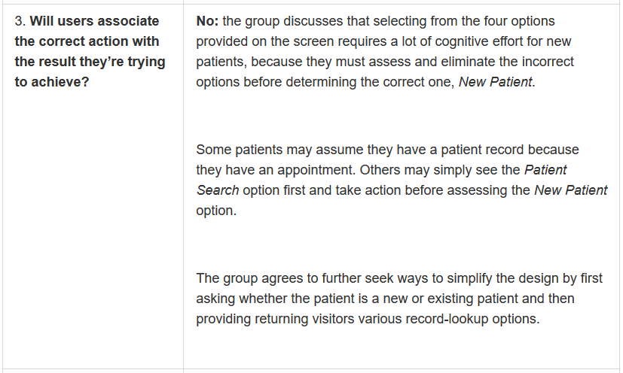

Slide 14
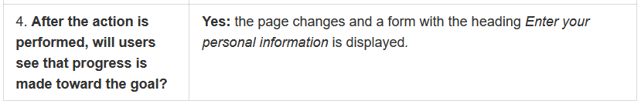

Slide 15
Are Cognitive Walkthroughs Appropriate for All Types of Interfaces?
Cognitive walkthroughs are best used to evaluate complex applications and systems that require new design patterns or interactions.

